Slide 1
Cscope, Ctags & Taglist
Karthikeyan K

Slide 2
Cscope
Cscope is a Linux tool that interactively examine a C program .
Also for browsing source code in a terminal environment.
Cscope was originally built to work with C code, but also works well with C++, Java, and some other languages.
Cscope can be a particularly useful tool if you need to wade into a large code base.

Slide 3
Cscope for Linux-4.17.1

Slide 4
Cscope for Linux-4.17.1
Default editor is vi; if you want to change it, set the CSCOPE_EDITOR environment variable,
e.g.: $ export CSCOPE_EDITOR=`which vim`
Recursively find all of the .c, .cpp, .h, and .hpp files in your current directory and any subdirectories, and store the list of these filenames in cscope.files:
$ cd linux-4.17.1
$ find . -name "*.c" -o -name "*.cpp" -o -name "*.h" -o -name "*.hpp" > cscope.files

Slide 5
Cscope for Linux-4.17.1
Pass the list of source files to Cscope, which will build a reference database:
$ cscope -q -R -b -i cscope.files or cscope -R -b
-q flag is used to build a faster (but larger) database.
-R tells Cscope to search for symbols recursively.
-b builds the database only, but does not start the Cscope browser.
-i cscope.files specifies the list of source files.
The output will be a set of files in your currentdirectory:
cscope.in.out, cscope.out, and cscope.po.out.
Start the Cscope browser:
$ cscope -d
-d flag tells Cscope not to regenerate the database.

Slide 6
Cscope for Linux-4.17.1
The browser will show you the list of the searches you can perform in your code
Find this global definition:
Find functions called by this function:
Find functions calling this function:
Find this text string:
Change this text string:
Find this egrep pattern:
Find this file:
Find files #including this file:

Slide 7
Ctags

Slide 8
Requirements
Install this package Exuberant-tags
$ sudo apt-get install exuberant-tags

Slide 9
Ctags
The ctags generates an index (or "tag") file for a variety of language objects found in file(s).
This tag file allows these items to be quickly and easily located by a text editor or other utility.
A "tag" signifies a language object for which an index entry is available.

Slide 10
Creating Tag File
Run Ctags recursively over the entire kernel to generate the tags file.
$ ctags options file(s)
$ ctags -R *.c
In case of a source tree which contains C files in different subdirectories, one can call ctags in the root directory of the sourcetree with the -R option and a tags file containing Tags to allfunctions in the source tree will be created.
linux-4.17.1$ ctags -R

Slide 11
Tag File Format
Each entry in the tag file consists of a separate line, and most general format:
tag_name<TAB>file_name<TAB>ex_cmd;"<TAB>extension_fieldsName of the tag
Name of the file in which the object associated with the tag is located
EX command used to locate the tag within the file; generally a search pattern or line number.
Extension fields are tab-separated [key:value] pairs appended to the end of the EX command as a comment.

Slide 12
Ctags with Vi
Vi will, by default, expect a tag file by the name "tags" in the current directory. The following commands exercise the tag indexing feature
vi −t tag --- Start vi and position the cursor at the file and line where "tag" is defined.
:ta tag --- Find a tag.
Ctrl-] --- Find the tag under the cursor.
Ctrl-T --- Return to previous location before jump to tag (not widely implemented).

Slide 13
Ctags with Vi
Following vim commands can be used to navigate through relevant functions
:ta /^get ---- will go to the function definition whose name starts with get
:ts – shows the list.
:tn – goes to the next tag in that list.
:tp – goes to the previous tag in that list.
:tf – goes to the function which is in the first of the list.
:tl – goes to the function which is in the last of the list.

Slide 14
Taglist

Slide 15
Taglist
Ctags might have not given a source code browsing feeling, as it is driven by commands instead of visually browsing the code. So if you want to navigate through the source as like navigating in the file browser, you need to use vim taglist plugin which makes vim as a source code browser.

Slide 16
Installation Of Taglist
Download the taglist plugin
Downloads$ wget -O taglist.zip http://www.vim.org/scripts/download_script.php?src_id=7701
$ mkdir ~/.vim # if the directory does not exist already
$ cd ~/.vim
$ unzip Downloads/taglist.zip

Slide 17
Installation Of Taglist
Enable the plugin in the ~/.vimrc
Add the following line to the ~/.vimrc to enable the plugin for Vim editor.
filetype plugin on
Pre-Requisite: ctags should be installed to use taglist plugin. But it is not a must to generate the tag list manually by ctags command for using taglist plugin.

Slide 18
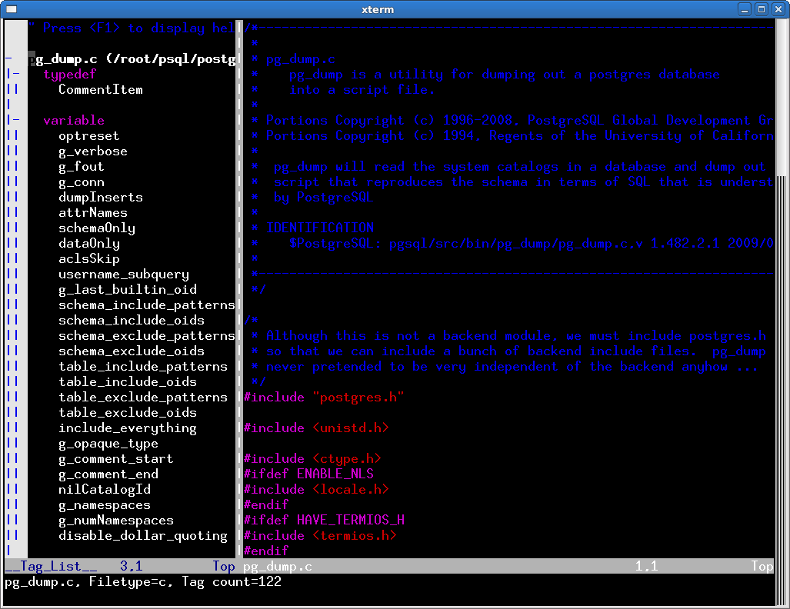
Features of Taglist Vim Plugin
From the vim editor, execute :TlistOpen, which opens the tag list window with the tags of the current file as shown in the figure below.

Slide 19
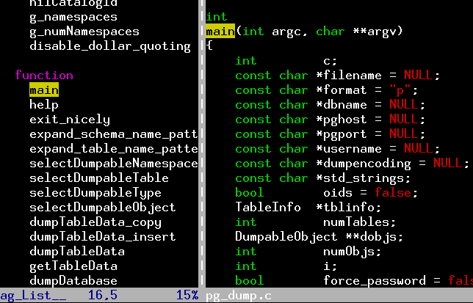
Jump to the Function Definition inside a source code
By clicking on the function name in the left panel, you would be able to go to the definition of the function as shown in the Figure below.

Slide 20
Time to Explore C

